Slide 1
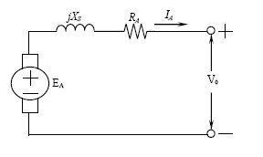
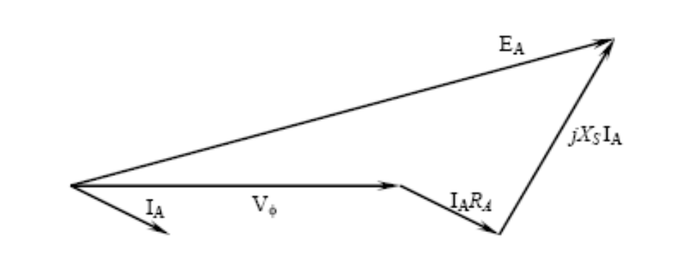
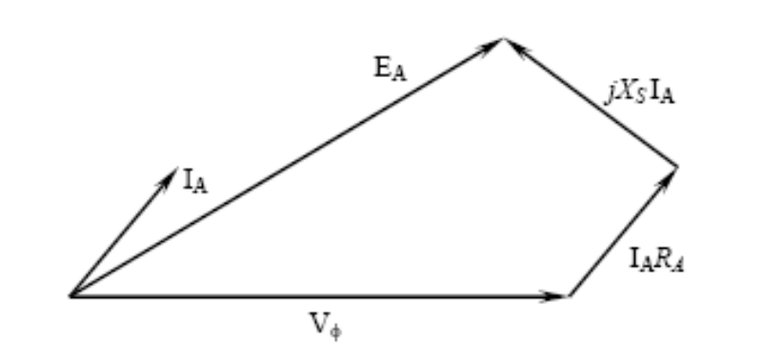
Phasor Diagram
Synchronous Generator
Phasor diagram of a synchronous generator at lagging factor (Inductive Load).
Phasor diagram of a synchronous generator at leading factor (Capacitive Load).
For a given field current and magnitude of load current, the terminal voltage is lower for lagging loads and higher for leading loads.

Slide 2
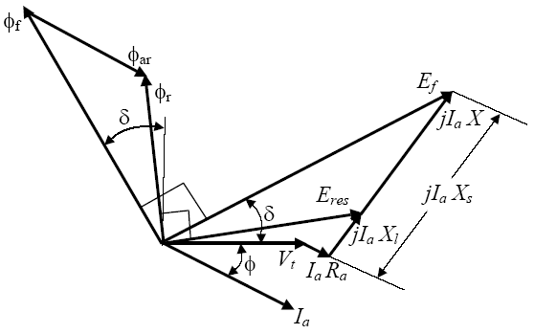
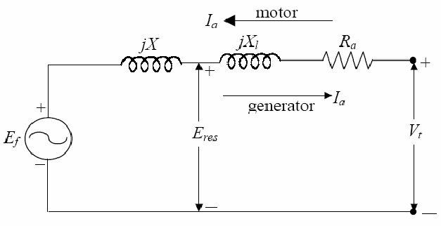
Synchronous Generator
Phasor Diagram
  The phasor diagram of a cylindrical-rotor synchronous generator is shown here, for the case of lagging power factor, with the armature current lagging behind the terminal voltage.
  Φ_{f} is the phasor of the rotor flux,
  Φ_{ar} is the phasor of the armature flux,
  Φ_{r} is the phasor of the airgap flux

Slide 3
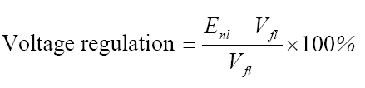
Synchronous Generator
Voltage regulation
  A convenient way to compare the voltage behavior of two generators is by their voltage regulation. The voltage regulation (VR) of a synchronous generator at a given load, power factor, and at rated speed is defined as:
  Where V_{fl} is the full-load terminal voltage, and E_{nl} (equal to E_{f}) is the no-load terminal voltage (internal voltage) at rated speed when the load is removed without changing the field current. For lagging power factor (PF), VR is fairly positive, for unity PF, VR is small positive and for leading PF, VR can be negative.

Slide 4
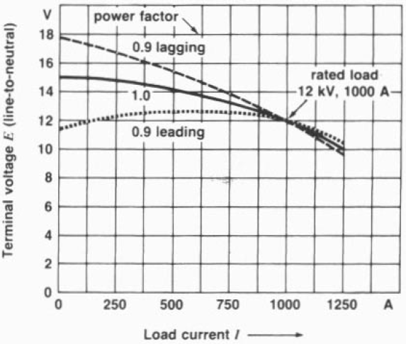
Synchronous Generator
Voltage regulation
The terminal voltage of the generator can be changed by adjusting the field current.

Slide 5
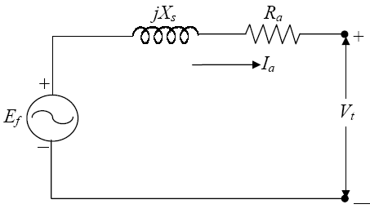
Synchronous Generator
Determination of the parameters of the equivalent circuit
  The parameters of the equivalent circuit of a synchronous generator can be determined by performing the following three tests:
  Open-circuit test
  Short-circuit test
  DC test

Slide 6
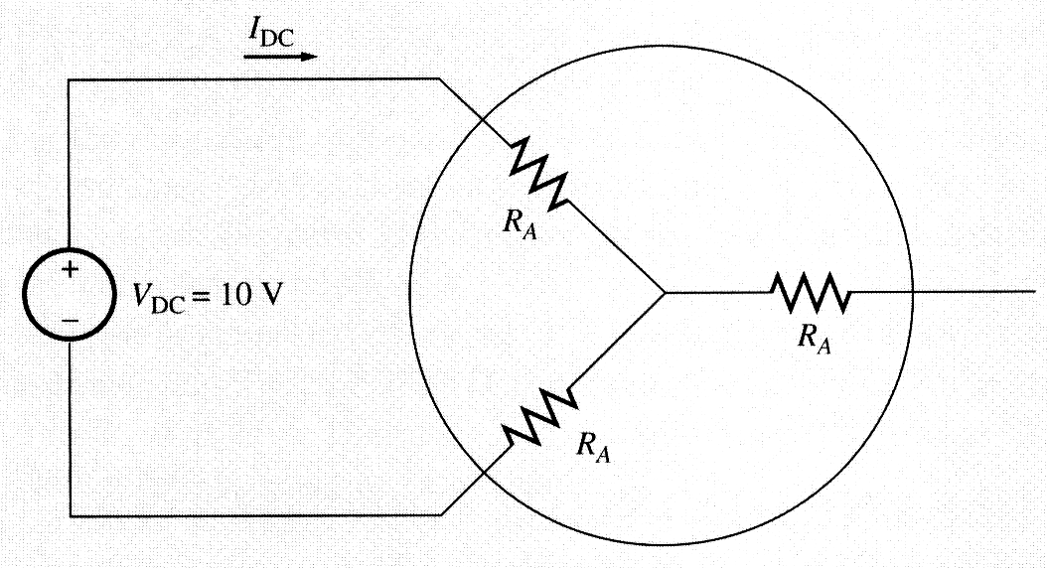
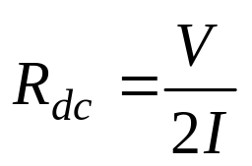
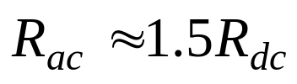
Synchronous Generator
Determination of the parameters of the equivalent circuit
  DC test:
  The resistance R_{a} can be approximated by applying a dc voltage to the armature windings while the machine is stationary and measuring the resulting current flow.
  This technique is not perfectly accurate, since the ac resistance will be slightly higher than the dc resistance (as a result of the skin effect at higher frequencies). The following approximation may be used as a rule of thumb.

Slide 7
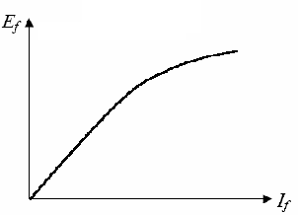
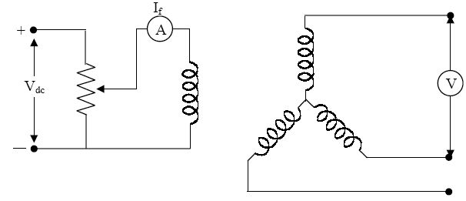
Synchronous Generator
Determination of the parameters of the equivalent circuit
  Open-circuit test:
  The generator is turned at the rated speed, the terminals are disconnected from all loads, and the field current is set to zero. Then the field current is gradually increased in steps, and the terminal voltage is measured at each step. It is thus possible to obtain an open-circuit characteristic of a generator (E_{f} or V_{t} versus I_{f}) from this information.

Slide 8
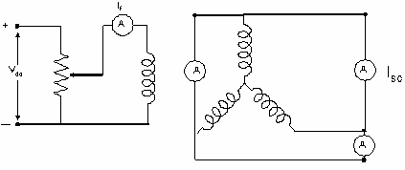
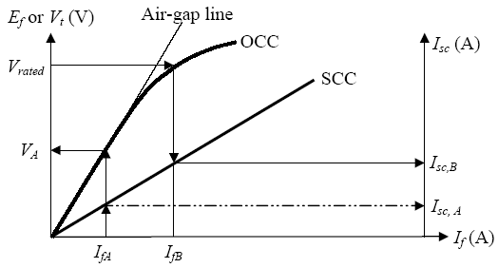
Synchronous Generator
Determination of the parameters of the equivalent circuit
  Short-circuit test
Adjust the field current to zero and short-circuit the terminals of the generator through a set of ammeters. Record the armature current I_{sc} as the field current is increased. Such a plot is called short-circuit characteristic. For a particular field current I_{f}, the internal voltage E_{f} could be found from the occ and the short-circuit current flow Ia,sc could be found from the scc. Then the synchronous reactance X_{s} could be obtained.
I_{sc}

Slide 9
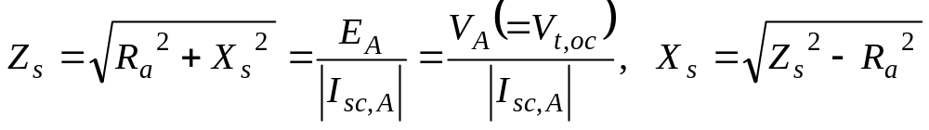
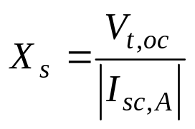
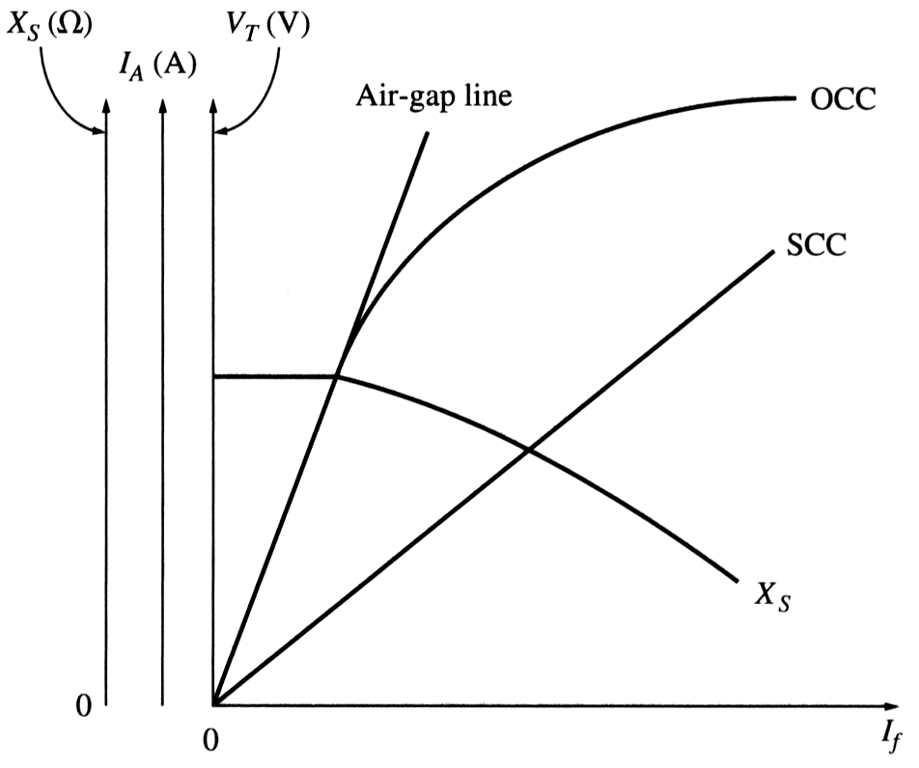
Synchronous Generator
Determination of the parameters of the equivalent circuit
Since X_{s} >> R_{A},
the equation reduces to:
The SCC is a straight line since, B_{S} almost cancels B_{R}, the net field B_{net} is very small.

Slide 10
Synchronous Generator
Determination of the parameters of the equivalent circuit
Problem with this method:
E_{A} is taken from the OCC whereby the core would be partially saturated for large field currents while I_{A} is taken from the SCC where the core is not saturated at all field currents. Therefore E_{A} value taken during the OCC may not be the same E_{A} value in the SCC test. Hence the value of X_{S} is only an approximate.

Slide 11
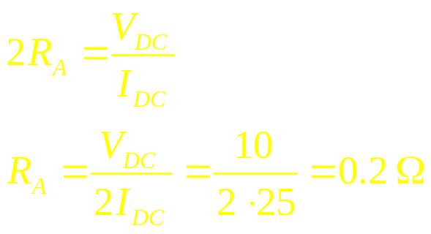
Measuring parameters of synchronous generator model: Ex
Example 7.1: A 200 kVA, 480 V, 50 Hz, Y-connected synchronous generator with a rated field current of 5 A was tested and the following data were obtained:
V_{T,OC} = 540 V at the rated I_{F}.
I_{L,SC} = 300 A at the rated I_{F}.
When a DC voltage of 10 V was applied to two of the terminals, a current of 25 A was measured.
Find the generator’s model at the rated conditions.
Since the generator is Y-connected, a DC voltage was applied between its two phases. Therefore:

Slide 12
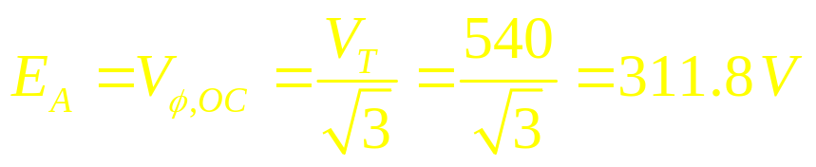
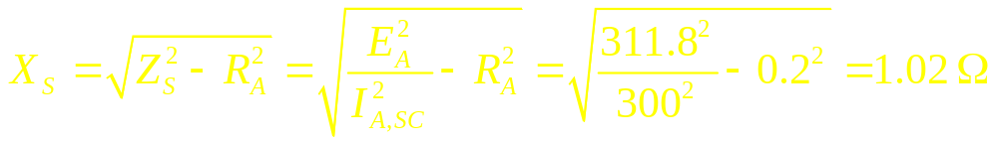
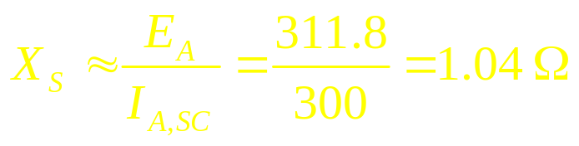
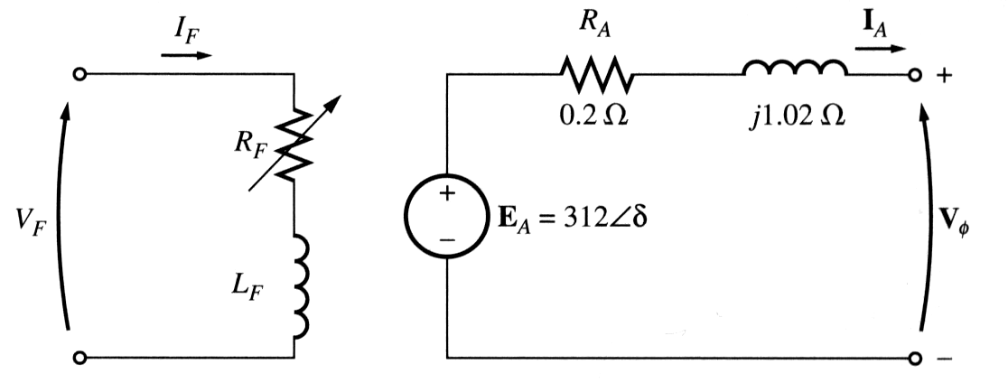
Measuring parameters of synchronous generator model: Ex
The internal generated voltage at the rated field current is
The synchronous reactance at the rated field current is precisely
We observe that if X_{S} was estimated via the approximate formula, the result would be:
Which is close to the previous result. The error ignoring R_{A} is much smaller than the error due to core saturation.
The equivalent circuit

Slide 13
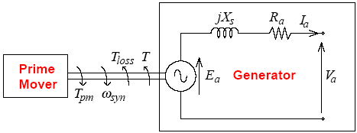
Synchronous Generator
Power and Torque in Synchronous Generators
In steady state, the mechanical power of the prime mover should
balance with the electrical power produced by the generator and the mechanical loss due to friction and windage,
P_{in}=P_{conv}+P_{loss}

Slide 14
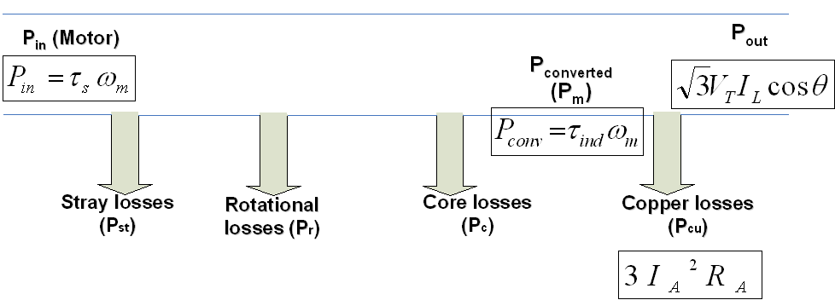
Synchronous Generator
Power and Torque in Synchronous Generators
The power-flow diagram for a synchronous generator is shown. Not all the mechanical power going into a synchronous generator becomes electrical power out of the machine. The difference between input power and output power represents the losses of the machine. The input mechanical power is the shaft power in the generator.

Slide 15


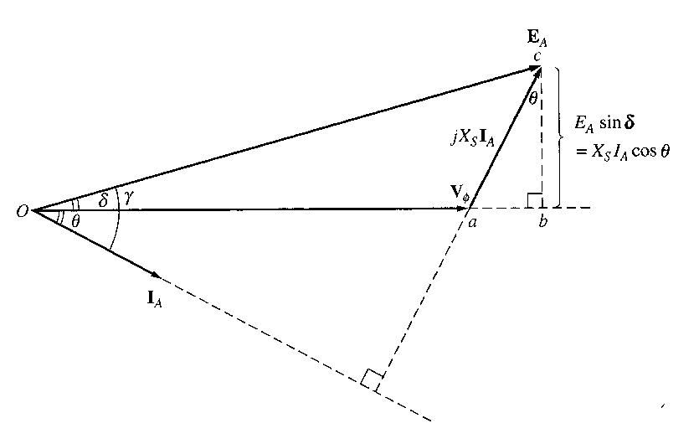
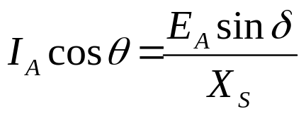
Synchronous Generator
Power and Torque in Synchronous Generators
Input Power:
Converted power:
Where γ is the angle between E_{A} and I_{A}.
If the armature resistance R_{A} is ignored (X_{S} >> R_{A}), Therefore;
; Where δ is the angle between E_{A} and V_{T} (V_{O})

Slide 16


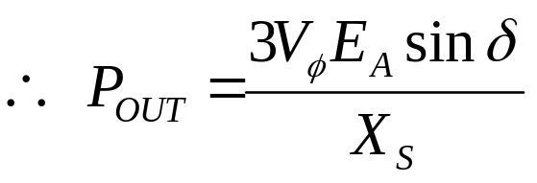
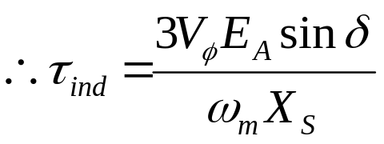
Synchronous Generator
Power and Torque in Synchronous Generators
Output Power:
Substituting I_{A} cosθ into P_{out}, gives;.
Neglecting R_{A} then the P_{out}=P_{conv.} and the induced torque can be express as;.
Notice that the torque angle δ (also known as power angle and load angle) is also the angle between the rotor magnetic field and the net (air gap) magnetic field.

Slide 17
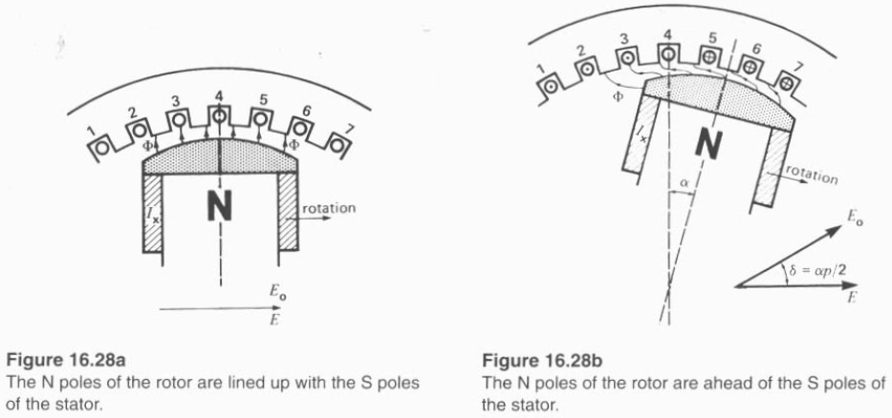
The Synchronous generator operating alone
Increase load effect on generators

Slide 18
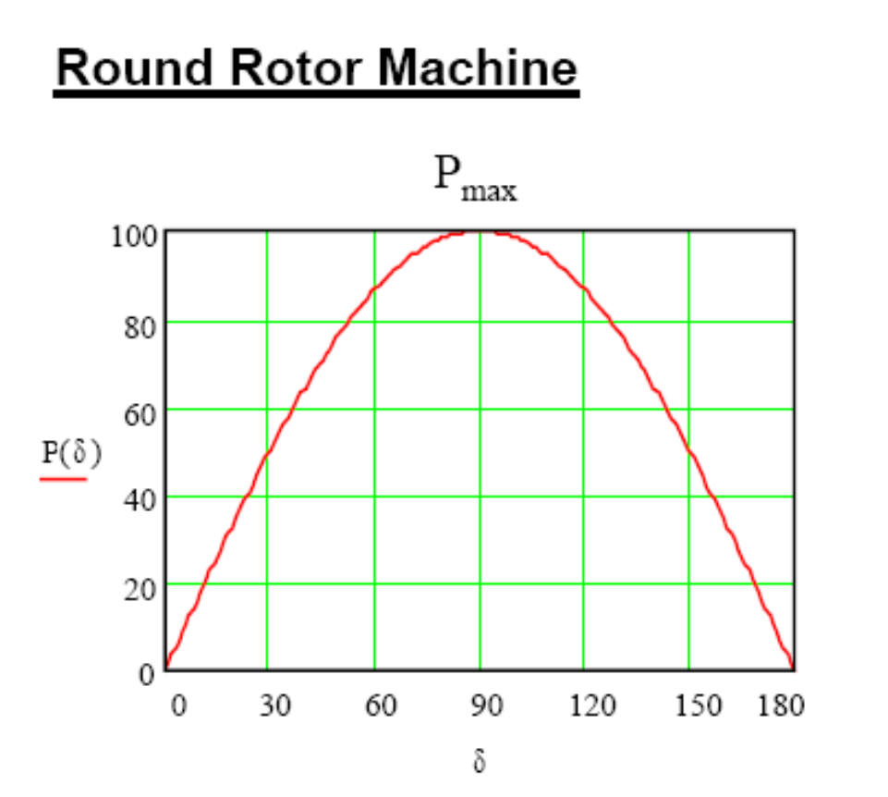
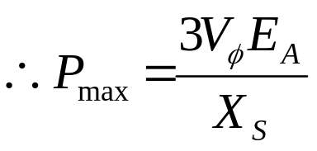
Synchronous Generator
Power and Torque in Synchronous Generators
The increase of power increases the angle between the induced voltage and the terminal voltage. δ is known as the torque angle of the machine.
The power is maximum when δ=90º
Further increase of input power forces the generator out of synchronism. This generates large current and mechanical forces.
The maximum power is the static stability limit of the system.
Safe operation requires a 15-20% power reserve.

Slide 19
The Synchronous generator operating alone: Example
Example : A 480 V, 60 Hz, Y-connected six-pole synchronous generator has a per-phase synchronous reactance of 1.0 Ω. Its full-load armature current is 60 A at 0.8 PF lagging. Its friction and windage losses are 1.5 kW and core losses are 1.0 kW at 60 Hz at full load. Assume that the armature resistance (and, therefore, the I²R losses) can be ignored. The field current has been adjusted such that the no-load terminal voltage is 480 V.
What is the speed of rotation of this generator?
What is the terminal voltage of the generator if
  It is loaded with the rated current at 0.8 PF lagging;
  It is loaded with the rated current at 1.0 PF;
  It is loaded with the rated current at 0.8 PF leading.
  c. What is the efficiency of this generator (ignoring the unknown electrical losses) when it is operating at the rated current and 0.8 PF lagging?
  d. How much shaft torque must be applied by the prime mover at the full load?
  how large is the induced countertorque?
  e. What is the voltage regulation of this generator at 0.8 PF lagging? at 1.0 PF? at 0.8 PF leading?

Slide 20
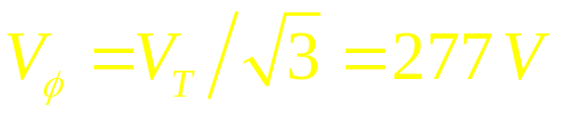
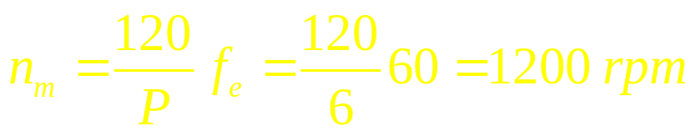
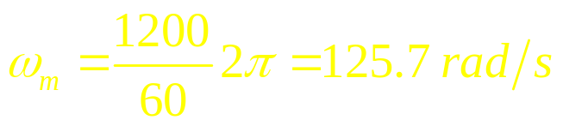
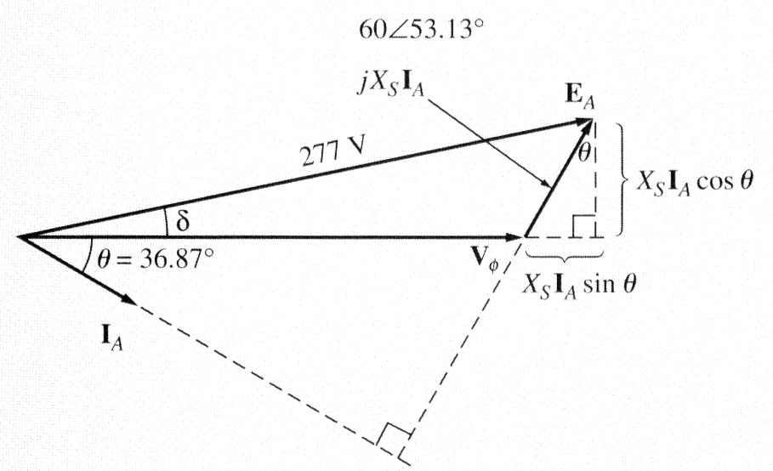
The Synchronous generator operating alone: Example
Since the generator is Y-connected, its phase voltage is
At no load, the armature current I_{A} = 0 and the internal generated voltage is E_{A} = 277 V and it is constant since the field current was initially adjusted that way.
a. The speed of rotation of a synchronous generator is
which is
b.1. For the generator at the rated current and the 0.8 PF lagging, the phasor diagram is shown. The magnitude of E_{A} is 277 V,

Slide 21
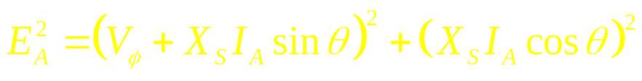
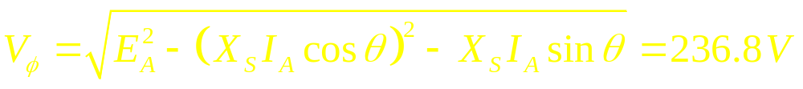
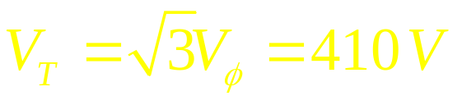
The Synchronous generator operating alone: Example
and that
Two unknown quantities are the magnitude of V_{φ} and the angle δ of E_{A}. From the phasor diagram:
Then:
Since the generator is Y-connected,

Slide 22
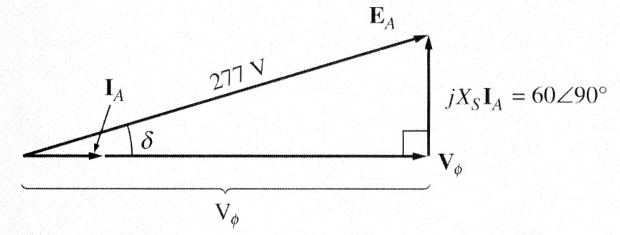
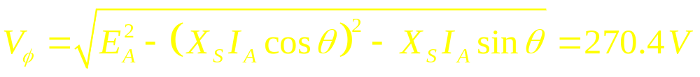
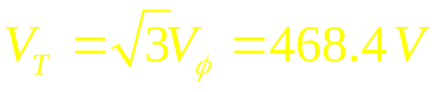
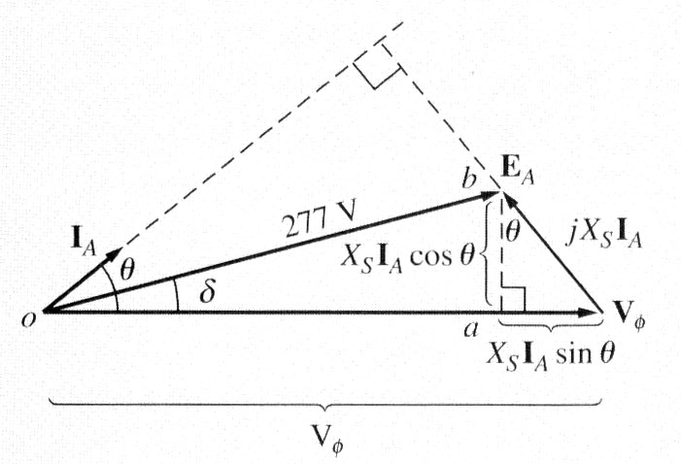
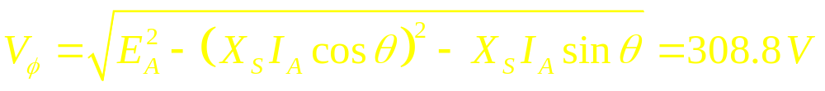
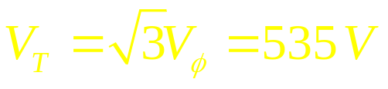
The Synchronous generator operating alone: Example
b.2. For the generator at the rated current and the 1.0 PF, the phasor diagram is shown.
Then:
and
b.3. For the generator at the rated current and the 0.8 PF leading, the phasor diagram is shown.
Then:
and

Slide 23
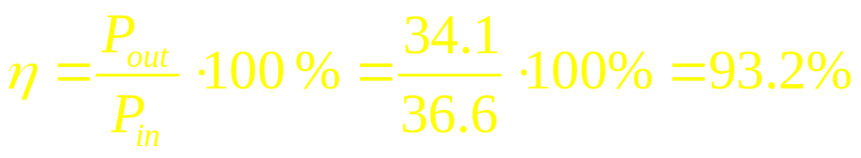
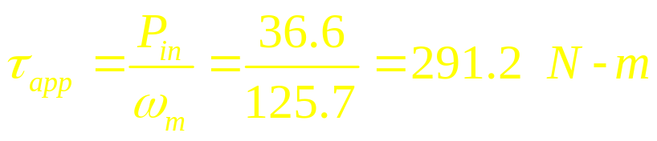
The Synchronous generator operating alone: Example
c. The output power of the generator at 60 A and 0.8 PF lagging is
The mechanical input power is given by
The efficiency is
d. The input torque of the generator is

Slide 24
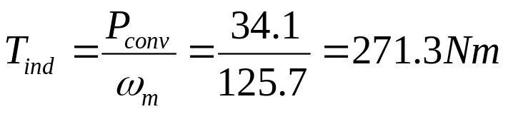
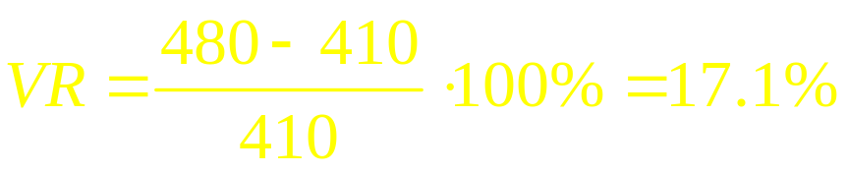
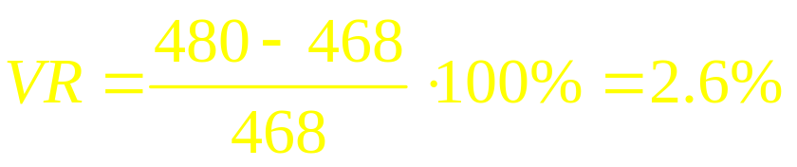

The Synchronous generator operating alone: Example
The induced countertorque of the generator is
e. The voltage regulation of the generator is
Lagging PF:
Unity PF:
Lagging PF:

Slide 25

Synchronous Generator
  Parallel operation of synchronous generators
Before connecting a generator in parallel with another generator, it must be synchronized. A generator is said to be synchronized when it meets all the following conditions:
1. The rms line voltages of the two generators must be equal.
2. The two generators must have the same phase sequence.
3. The phase angles of the two a phases must be equal.
4. The oncoming generator frequency is equal to the running system frequency.

Slide 26

General procedure for paralleling generators

Slide 27

Conditions required for paralleling
If the phase sequences are different, then even if one pair of voltages (phases a) are in phase, the other two pairs will be 120⁰ out of phase creating huge currents in these phases.
If the frequencies of the generators are different, a large power transient may occur until the generators stabilize at a common frequency. The frequencies of two machines must be very close to each other but not exactly equal. If frequencies differ by a small amount, the phase angles of the oncoming generator will change slowly with respect to the phase angles of the running system.
If the angles between the voltages can be observed, it is possible to close the switch S₁ when the machines are in phase.

Slide 28

General procedure for paralleling generators
When connecting the generator G₂ to the running system, the following steps should be taken:
Adjust the field current of the oncoming generator to make its terminal voltage equal to the line voltage of the system (use a voltmeter).
Compare the phase sequences of the oncoming generator and the running system. This can be done by different ways:
  Connect a small induction motor to the terminals of the oncoming generator and then to the terminals of the running system. If the motor rotates in the same direction, the phase sequence is the same;
2) Connect three light bulbs across the open terminals of the switch. As the phase changes between the two generators, light bulbs get brighter (large phase difference) or dimmer (small phase difference). If all three bulbs get bright and dark together, both generators have the same phase sequences.

Slide 29

General procedure for paralleling generators
If phase sequences are different, two of the conductors on the oncoming
generator must be reversed.
3. The frequency of the oncoming generator is adjusted to be slightly higher than
the system’s frequency.
4. Turn on the switch connecting G₂ to the system when phase angles are equal.
The simplest way to determine the moment when two generators are in phase is by observing the same three light bulbs. When all three lights go out, the voltage across them is zero and, therefore, machines are in phase.
A more accurate way is to use a synchroscope – a meter measuring the difference in phase angles between two a phases. However, a synchroscope does not check the phase sequence since it only measures the phase difference in one phase.
The whole process is usually automated…

Slide 30

Synchronous Generator
  Concept of the infinite bus

Slide 31

Synchronous Generator
  Concept of the infinite bus
When a synchronous generator is connected to a power system, the power system is often so large that nothing the operator of the generator does will have much of an effect on the power system.
An infinite bus is a power system so large that its voltage and frequency do not vary regardless of how much real or reactive power is drawn from or supplied to it.
The external network is represented by a voltage source and an equivalent reactance. A large network’s impedance is very small, we assume X_{e} = 0 and V_{en} = V_{tn}
Generator
Network
jX_{s}
X_{e}=0
I_{a}
δ
E_{fn}
0
V_{tn}
V_{en}

Slide 32

Synchronous Generator
  Concept of the infinite bus
Notice that when E_{A} stays constant (field current and speed are the same), E_{A}sinδ (which is proportional to the output power if V_{T} is constant) increases when the input power is increased.

Slide 33



Active and reactive power-angle characteristics
P_{m}
The complex power output of the generator in volt-amperes per phase is given by
P_{e}, Q_{e}
V_{t}
where:
V_{t} = terminal voltage per phase
I_{a}* = complex conjugate of the armature current per phase
Taking the terminal voltage as reference
the excitation or the generated voltage,

Slide 34



Active and reactive power-angle characteristics
and the armature current,
where X_{s} is the synchronous reactance per phase.
P_{m}
P_{e}, Q_{e}
V_{t}

Slide 35


Steady-state stability limit
Total three-phase power:
The above equation shows that the power produced by a synchronous generator depends on the angle δ between the V_{t} and E_{f}. The maximum power that the generator can supply occurs when δ=90º.
The maximum power indicated by this equation is called steady-state stability limit of the generator. If we try to exceed this limit (such as by admitting more steam to the turbine), the rotor will accelerate and lose synchronism with the infinite bus. In practice, this condition is never reached because the circuit breakers trip as soon as synchronism is lost. We have to resynchronize the generator before it can again pick up the load. Normally, real generators never even come close to the limit. Full-load torque angle of 15º to 20º are more typical of real machines.

